Slide 1
CS 2200
LAB 7

Slide 2
Announcements
Project 2 Demos begin tomorrow
-25% for missing demos!!!
Exam 2 next week in lab! (BRING ID)
Everything up until paging (not including paging)
Same logistics as Exam 1
Project 3 is released and will be due 3/15
Office hours will get busy, so start early!

Slide 3
Today’s Topics:
Scheduling Algorithms, Metrics, & Memory Management

Slide 4
A Summary of CS 2200 so far
We built a simple datapath that reads a program from memory and executes it (Chapter 2-3).
We gave our datapath the capability to handle interrupts to service I/O requests (Chapter 4).
We built a more efficient datapath which can execute one instruction in one clock cycle on average (Chapter 5).

Slide 5
Scheduling Metrics

Slide 6
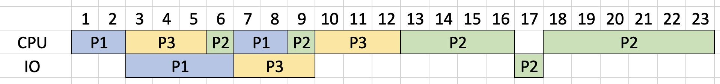
Let’s evaluate the performance of the following timeline

Slide 7
Exercise: Response Time
Response Time calculates the completion time of a given process.
What is the response time for P1?

Slide 8
Exercise: Response Time
Response Time calculates the completion time of a given process.
What is the response time for P1?
8

Slide 9
Exercise: Response Time
Response Time calculates the completion time of a given process.
What is the response time for P2?

Slide 10
Exercise: Response Time
Response Time calculates the completion time of a given process.
What is the response time for P2?
23

Slide 11
Exercise: Response Time
Response Time calculates the completion time of a given process.
What is the response time for P3?

Slide 12
Exercise: Response Time
Response Time calculates the completion time of a given process.
What is the response time for P3?
12

Slide 13
Exercise: Average Response Time
Average Response Time is the average of the response time.
What is the average response time for P1, P2, and P3?

Slide 14
Exercise: Average Response Time
Average Response Time is the average of the response time.
What is the average response time for P1, P2, and P3?
(8 + 23 + 12) / 3 = 14.33

Slide 15
Exercise: Wait Time
Wait Time calculates the amount of time a given process spends not
executing, or waiting inside the ready queue.
What is the wait time for P1?

Slide 16
Exercise: Wait Time
Wait Time calculates the amount of time a given process spends not
executing, or waiting inside the ready queue.
What is the wait time for P1?
0

Slide 17
Exercise: Wait Time
Wait Time calculates the amount of time a given process spends not
executing, or waiting inside the ready queue.
What is the wait time for P2?

Slide 18
Exercise: Wait Time
+5
+2
+3
Wait Time calculates the amount of time a given process spends not
executing, or waiting inside the ready queue.
What is the wait time for P2?
10

Slide 19
Exercise: Wait Time
Wait Time calculates the amount of time a given process spends not
executing, or waiting inside the ready queue.
What is the wait time for P3?

Slide 20
Exercise: Wait Time
+1
+2
Wait Time calculates the amount of time a given process spends not
executing, or waiting inside the ready queue.
What is the wait time for P3?
3

Slide 21
Exercise: Average Wait Time
Average Wait Time is the average of the wait time.
What is the average wait time?

Slide 22
Exercise: Average Wait Time
Average Wait Time is the average of the wait time.
What is the average wait time?
(0 + 10 + 3) / 3 = 4.33

Slide 23
Exercise: Throughput
Throughput measures the number of processes that execute in a given period.
What is the total throughput?

Slide 24
Exercise: Throughput
Throughput measures the number of processes that execute in a given period.
What is the total throughput?
3 processes / 23 seconds = 0.13 pcs/sec

Slide 25
Exercise: Processor Utilization
Processor Utilization measures the percentage of time that the processor spends running jobs.
What is the processor utilization?

Slide 26
Exercise: Processor Utilization
Processor Utilization measures the percentage of time that the processor spends running jobs.
What is the processor utilization?
22/23 = 95.7% utilization

Slide 27
Scheduling Metrics Summary
Metric | Details | Calculation | Centric
Throughput | Number of jobs per unit time | #jobs/time | System
Response Time | Turnaround time for a job to finish | completion time | User
Average Response Time | Average elapsed time between job entering and leaving a system | sum(completion time)/#jobs | System
Wait Time | Amount of time job spends not executing on the processor or IO queue. | completion time - job length | System
Average Wait Time | Average time a job is in the ready queue | sum(wait time)/#jobs | System
CPU Utilization | Percentage of processor that is utilized. | busytime/totaltime | System

Slide 28
Scheduling Algorithms

Slide 29
Exercise: What scheduling algorithm is used?
Take 5 minutes to think about what possible scheduling algorithm was used in the previous timeline.
Possible algorithms include:
FCFS
SJF
Priority
SRTF
Round Robin

Slide 30
Exercise: What scheduling algorithm is used?
Take 5 minutes to think about what possible scheduling algorithm was used in the previous timeline.
Possible algorithms include:
FCFS
SJF
Priority
SRTF
Round Robin

Slide 31
Preemptive vs Non-preemptive
Non-preemptive Preemptive
Waits for the current process to ﬁnish/release control of the processor before performing a context switch
Will NOT stop the current process.
Able to halt execution of the current process and kick it oﬀ the processor.
Uses some metric to determine when a process’s time is done and the next process should go.
Preemptive = Non-preemptive + Interrupts

Slide 32
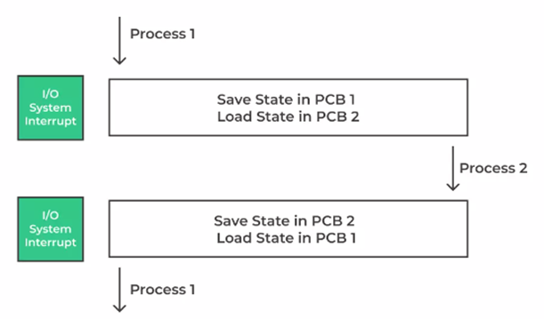
Common steps for Scheduling Algorithms
Notify the processor.
Save the state of the current process to its corresponding PCB.
Select a new process to run (based on scheduling algorithm).
Invoke the dispatcher and context switch the current process out and the new one in.

Slide 33
Example Program
Process | CPU_1 | IO_1 | CPU_2
P1 | 2 | 3 | 4
P2 | 15 | 2 | 6
P3 | 6 | 6 | 2

Slide 34
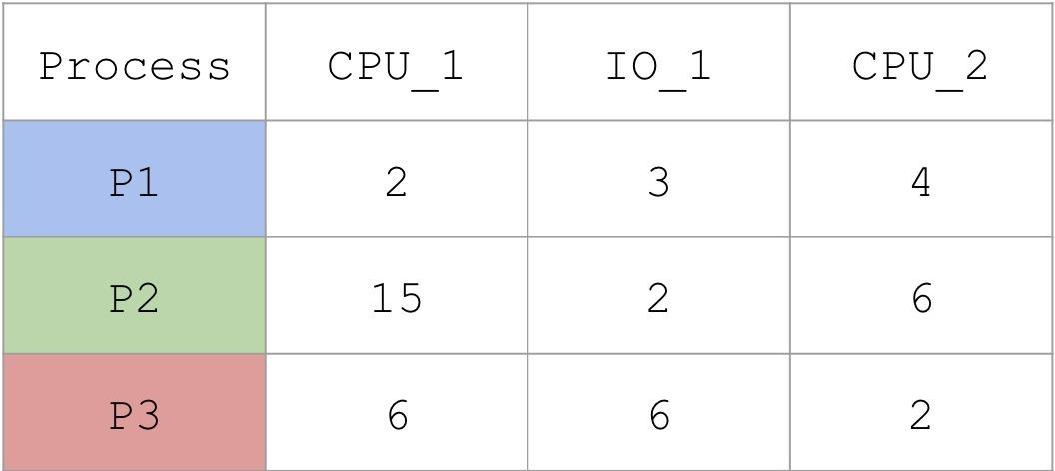
Non-Preemptive - First Come First Serve (FCFS)
Treat the ready queue as an actual FIFO queue by arrival time, with the element at the head being chosen to get scheduled.
Assume the processes arrive in order: [P1, P2, P3]
Exercise: How does the scheduler schedule these processes?
Note: The arrival time used is when an application is launched. This “launch” time is the metric used to determine the scheduling order even if the process completes I/O and enters the ready queue again.

Slide 35
Non-Preemptive - First Come First Serve (FCFS)
We schedule processes based on their arrival time to the ready queue.
What drawbacks could we see here?

Slide 36
Non-Preemptive - First Come First Serve (FCFS)
Treat the ready queue as an actual FIFO queue, with the element at the head being chosen to get scheduled.
Drawback - Convoy Eﬀect

Slide 37
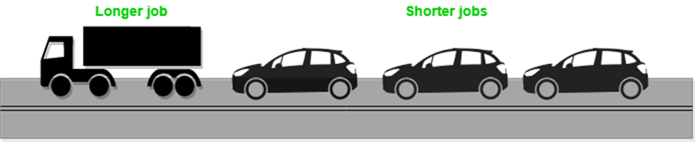
Convoy Eﬀect
If a process takes a very large amount of time, the other processes behind it will be unable to ﬁnish even if they could be executed quickly
Common in non-preemptive algorithms

Slide 38
Non-Preemptive - Shortest Job First (SJF)
Choose the shortest job (CPU Burst) to execute on the machine.
Exercise: How would the scheduler schedule these processes?
Note: The textbook says to determine “shortest” job based on the next CPU burst. However, some questions on HW / Exam may ask to use the sum of all CPU bursts. The questions will specify how to compute the shortest job.
4

Slide 39
Non-Preemptive - Shortest Job First (SJF)
Choose the shortest job (CPU Burst) to execute on the machine.
What drawbacks could we see here?
4
7
7
7

Slide 40
Non-Preemptive - Shortest Job First (SJF)
Choose the shortest job to execute on the machine.
Drawback - Starvation
4
7
7
7

Slide 41
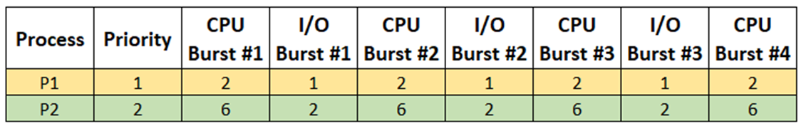
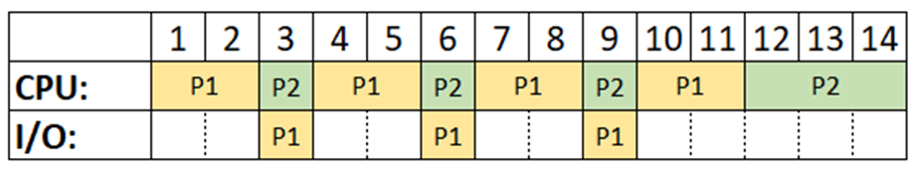
Starvation
If a process does not make any progress towards completion due to scheduling algorithms never letting it run. (Primarily preemptive, but not always)
Using preemptive priority:

Slide 42
Preemptive - Priority
Sort the ready queue by priority, and choose the job with the highest priority. This ensures that important processes that need to execute occur and do not get starved.
How would the scheduler schedule these processes?
Priority: [P3, P2, P1]
4
7
7
7

Slide 43
Preemptive - Priority
Sort the ready queue by priority, and choose the job with the highest priority. This ensures that important processes that need to execute occur and do not get starved.
What drawbacks could we see here?
4
7
7
7

Slide 44
Preemptive - Priority
Sort the ready queue by priority (typically in ascending order, meaning P3 has highest priority), and choose the job with the highest priority. This ensures that important processes that need to execute occur and do not get starved.
Drawback - Starvation
4
7
7
7

Slide 45
Preemptive - Shortest Remaining Time First (SRTF)
Sort the ready queue to SJF, however if a new job enters the ready queue, and its (CPU) time is shorter than the rest, it can preempt the running process, with that process reentering the ready queue.
How would the scheduler schedule these processes?
Note: The textbook says to determine “shortest” job based on the next CPU burst. However, some questions on HW / Exam may ask to use the sum of all CPU bursts. The questions will specify how to compute the shortest job.
4
7
7
7

Slide 46
Preemptive - Shortest Remaining Time First (SRTF)
A special case of SJF with preemption.
If the remaining (CPU) time of process in ready queue is lower than currently running process, then the scheduler preempts the latter in favor of the former.
What drawbacks could we see here?
4
7
7
7

Slide 47
Preemptive - Shortest Remaining Time First (SRTF)
4
Drawback: Starvation
7
7
7

Slide 48
Preemptive - Round Robin
Allocate a certain amount of time to each process (time slice). Once each process uses its allocated time, it will give time to the next process in the ready queue, and the process that was preempt will join the back of the queue, in a round robin fashion.
With a timeslice of 4, how would the scheduler schedule these processes?
4
7
7
7

Slide 49
Preemptive - Round Robin
Allocate a certain amount of time to each process (time slice). Once each process uses its allocated time, it will give time to the next process in the ready queue, and the process that was preempted will join the back of the queue, in a round robin fashion.
What drawbacks could we see here?

Slide 50
Preemptive - Round Robin
Each process gets a certain amount of time on CPU (time slice)
After a process runs for the time slice length, it is preempted and placed on ready queue
Next process in queue begins its time on CPU
Drawback - Context Switching Overhead
Note: Choosing a small time slice increases the overhead, but too large doesn’t divide time evenly

Slide 51
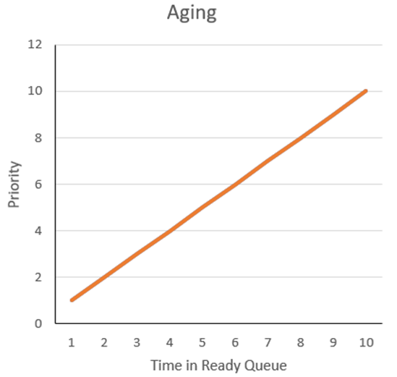
Aging
A technique for preemptive scheduling algorithms that gives a preference to processes that have been sitting in the ready queue for a long time
Addresses the issue of starvation

Slide 52
Potential Implementations:
Preemptive Priority: After a process has spent x seconds in ready queue, increment its priority
SRTF: If a process has spent x seconds in ready, it is automatically the next process to be dequeued, or it preempts (override SRTF principle)
Note: Choosing aging rate can make or break it’s effectiveness

Slide 53
Memory Management

Slide 54
Why do we need memory management
We have multiple programs in memory now
Isolation - we need to isolate processes from one another
We don’t want process 1’s data to overwrite process 2’s data in memory
We can’t trust processes to be well behaved
Resource sharing - we want all programs to be able to use the limited physical memory we have.
Abstract resource limitations - make the user programs think that they can address memory as large as the disk.

Slide 55
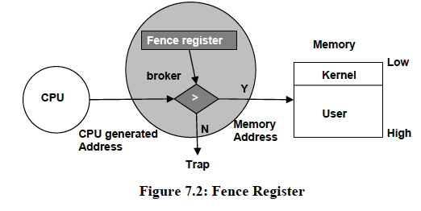
Fenced Memory Management - A Naive Approach
Hardware separation of User and Kernel space.
Drawback - Only one process can be present in the User space.

Slide 56
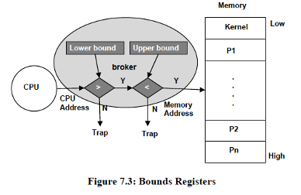
Exercise: Upper/Lower Bound Registers
If we are running Process 2 in “user” mode with a lower bound of 0x5FFF and an upper bound of 0x7000, what happens when we try to write to address:
0x7FFF?
0x2200?
0x6EEE?

Slide 57
Solution: Upper/Lower Bound Registers
If we are running Process 2 in “user” mode with a lower bound of 0x5FFF and an upper bound of 0x7000, what happens when we try to write to address:
0x7FFF -> trap on address violation
0x2200 -> trap on address violation
0x6EEE -> Successfully write to memory

Slide 58
Exercise: Upper/Lower Bound Registers
If we are running Process 2 in “kernel” mode with a lower bound of 0x5FFF and an upper bound of 0x7000, what happens when we try to write to address:
0x7FFF?
0x2200?
0x6EEE?

Slide 59
Solution: Upper/Lower Bound Registers
If we are running Process 2 in “kernel” mode with a lower bound of 0x5FFF and an upper bound of 0x7000, what happens when we try to write to address:
0x7FFF -> Successful write to memory
0x2200 -> Successful write to memory
0x6EEE -> Successful write to memory

Slide 60
Static Relocation Memory Management
Processes PCB will hold the values for the upper and lower bound, that are calculated at link time.
Allows processes to be swapped into and out of memory, however it cannot be placed anywhere in memory, only where it has been assigned.
Drawback - Poor memory utilization.

Slide 61
Thanks for attending :)

